Slide 1
Initial Problems Of Pakistan

Slide 2
Difficulties Of Pakistan
Initial problems of Pakistan.
The Civil Service of Pakistan.
Armed Forces of Pakistan.
Role of Armed Forces in Pakistan.

Slide 3
Initial Problems:
1. Choice of Capital and Establishment of Government.
2. Radcliff’s Award – an Unfair Boundary Distribution.
3. Accession of Princely States.
4. The Massacre of Muslim Refugees in India.
5. Division of Armed Forces and Military Assets.
6. Division of Financial Assets.
7. Indus Water Dispute.
8. Economic Problems.

Slide 4
Cont.
9. Administrative Problems.
10. Linguistic Riots.
11. Constitutional Problems.
12. Electricity Problem.
13. Kashmir Dispute.
14. India Office Library.
15. Membership of International Organizations.
16. Death of Quaid-e-Azam.

Slide 5
INTRODUCTION
Pakistan came into existence on 14th August 1947. Soon after its establishment, Pakistan had to face a number of problems.
Most of them were related with Pakistan disputes with India.
Such as the Accession of Princely States, Canal Water Dispute, Refugee’s problems and Distribution of Armed and Military Assets. Infact most of these problems were deliberately created by India itself so that Pakistan would not maintain its Independent Status and soon will merge with India.
Nehru told General Sir Frank Walter Messervy in 1945:
“His deliberate plan would be to allow Jinah to have his Pakistan, and gradually make things so impossible economically for Pakistan that they have to come on their banded knees and asked to be allowed back to India”.

Slide 6
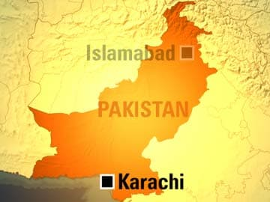
1. Choice of Capital and Establishment of Government:
The first problem that Pakistan faced was to choose a capital to form a Government and to establish a secretariat.
Karachi was chosen as the capital of Pakistan.
Quaid e Azam took the office of the Governor General, Liaquat Ali Khan was appointed as the Prime Minister and a Cabinet of experienced persons was selected.

Slide 7
2. Unfair Boundary Distribution:
Two Boundary Commissions were set up under a British Chairman, Sir Cyril Radcliff for the division of Punjab and Bengal.
Each Commission was consist of two representatives of Muslim League and two from Congress.
All of them were High Court Judges.
It was mutually agreed that in case of conflict the Chairman should give his verdict.
So, he misused his powers and handed over Muslims majority areas like Gurdaspur, Ferozpur and Junagadh to India hence providing them a gateway to Kashmir.
Quaid e Azam called it “ An Unjust, Incomprehensible and even perverse award.”

Slide 8
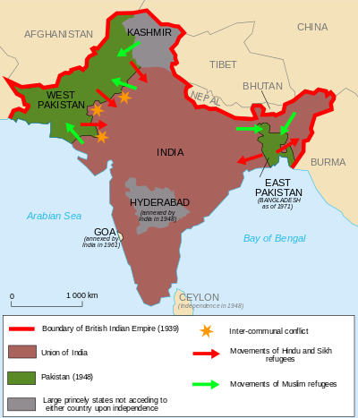
Unfair Boundary Distribution

Slide 9
3. Accession of Princely States:
Prior to partition, there were some semi-autonomous princely states existed in British India whose future had to be settled before Britain withdrew from India.
They were 560 in number all over the Sub-continent.
On July 25th, 1947, Lord Mountbatten (the last Viceroy of United India) addressed to the chamber of Princes and advised them that in deciding the question of accession, they should take into consideration the communal composition and the geographical location of their states.

Slide 10
Nearly all the states accepted the reality of the situation and opted either for Pakistan or India accordingly.
There were few states Junagadh, Hyderabad, Jodhpur and Kashmir which defied the principle of partition.

Slide 11
4. The Massacre of Muslim Refugees in India:
Above all other concerns, were the violence and refugees problem.
Jinah’s plea to regard religion as a personal matter, not a state matter, was ignored.
On the birth of Pakistan, Hindus and Sikhs became more furious.
In a planned move, Muslim properties were set on fire and they were compelled to leave Bharat for Pakistan with nothing but their lives.

Slide 12
Millions of refugees were killed before they reached Pakistan.
The most conservative estimates of the casualties were 250,000.
Many migrants were looted and had to be provided boarding immediately as they reached Pakistan.

Slide 13
5. Division Of Armed Forces and Military Assets:
For the security and safeguard of its territory, Pakistan needed armed forces and military equipment.
It became a sensitive issue for Pakistan which demanded the immediate division of army assets and personnel.
No problem was faced with regard to the division of soldiers but the Indian leaders created many difficulties in the division of military assets and equipment.
Pakistan received was nothing but scrap and out of order machines, broken weapons, unserivceable artillery and aircrafts.

Slide 14
There were 16 ordinance factories and all were located in India. Pakistan was given 60 million rupees towards its share in the Ordinance Factories.
Pakistan did not receive the due share of the military assets till now.
This dishonest attitude put Pakistan into great difficulties.

Slide 15

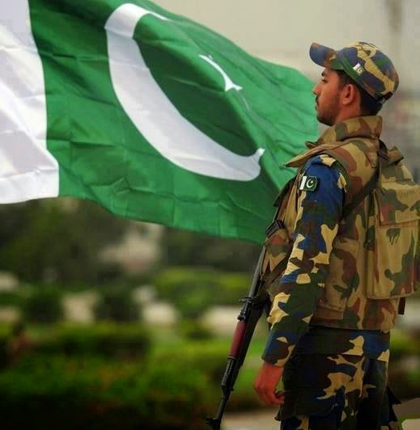
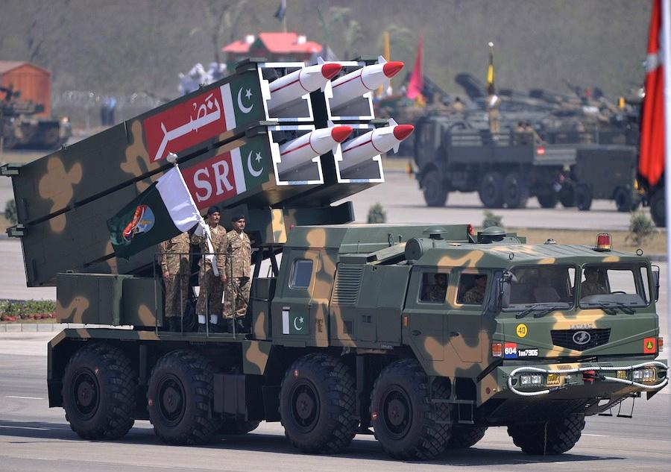

Division Of Military Assets

Slide 16


6. Division Of Financial Assets:
At the time of division there was cash balance of 4 billion rupees in the reserve Bank of India which was to be divided between India and Pakistan.
Pakistan was to receive 750 million rupees, which was initially delayed by the Indian Government. After the protest of Pakistan, India agreed to pay 200 million rupees. As the war between India and Pakistan started on Kashmir issue India again stopped the rest of the amount.
However the remaining 50 million rupees are still not paid. The money was Pakistan’s rightful share. India deliberately withhold it because they hoped that Pakistan would become Bankrupt.

Slide 17
7. Canal Water Dispute:
The boundary of India and Pakistan in a way that it cut across the rivers and canals, make India the Upper beneficiary and Pakistan the Lower beneficiary.
Most of the rivers flowing in Pakistan have their origin in India.
In 1948, India Stopped water supply to Pakistani canals to damage the Pakistani agriculture.
However, on 9thSeptember, 1960 an agreement called Indus Basin Treaty was signed between the two countries.

Slide 18
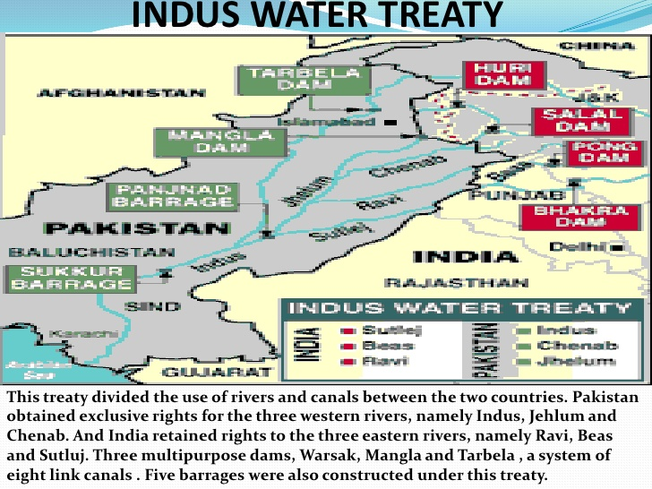
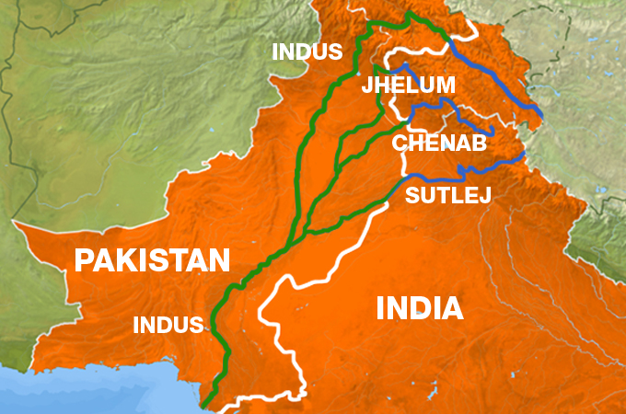
Canal Water Dispute

Slide 19
8. Economic Problems:
When Pakistan came into existence, it was mostly consisted of economically backward and underdeveloped areas.
The agricultural system was obsolete and outdated which added to the economics backwardness of the areas forming part of Pakistan.
The entire capital was in the hands of the Hindus.
Unfortunately, the banks and other financial institutions were located in Indian territory.
Besides these factors the technical experts and laborers, who operated the industries, were all Hindus because the Muslims extremely lagged behind in education and financial capabilities.

Slide 20


Economic Problems:

Slide 21
9. Administrative Problems:
The Government of Pakistan could not get enough time to set up workable administrative machinery because of the great difficulties created by Congress.
The Indian Government delayed in transferring the Government servants and official record which aggravated the situation.

Slide 22
The biggest administrative problem faced by Pakistan was the acute shortage of competent and experienced personnel in the Central and Provincial Governments.
Furthermore, there were not enough chairs, tables or even stationary and paper pins for administrative purposes.
Quaid-e-Azam paid his immediate attention towards setting up of administrative machinery and took number of steps to overcome administrative problems of a new state.

Slide 23
10. Issue Of National Language:
After the establishment of Pakistan, language controversy was started between East and West Pakistan.
The members of the Constituent Assembly belonged to East Pakistan demanded Bengali as National Language of Pakistan instead of Urdu.
In March 1948 while addressing at Dhaka, Quaid e Azam declared,
“Urdu and Urdu alone would be the national language of Pakistan”.
Urdu/BeNgali

Slide 24
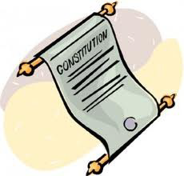
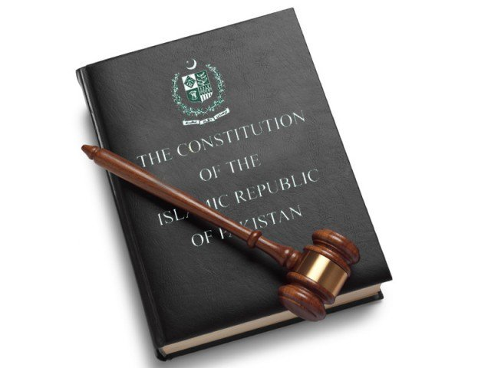
11. Constitutional Problems:
At the time of establishment of Pakistan the Government of India Act 1935 became the working constitution of Pakistan with certain adaptations.
The need of a constitution framed by the elected representatives of the people was necessary for free people.
So the first constitution assembly was formed and was given the task to frame the constitution for the country.
But the constituent assembly failed to frame a constitution even in eight years.
Lack of a permanent constitution created chances of corrupt interference in democratic progress of Pakistan.

Slide 25
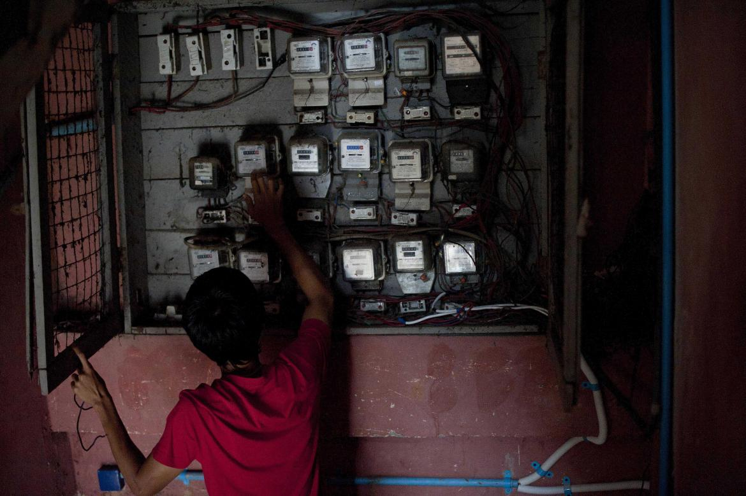

12. Electricity Problems:
Due to transfer of Muslim majority areas to Bharat and unfair demarcation, electricity system of West Punjab was disrupted, because all power stations were at Mundi, a predominantly Muslim majority area, gifted to Bharat but Quaid e Azam said;
“If we are to exist as a nation, we will have to face the problems with determination and force”.

Slide 26
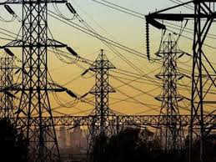

Slide 27
13. Kashmir Dispute:
Kashmir dispute is the most important and unsolved problem.
Kashmir is the natural part of Pakistan because at the time of partition 85% of the Kashmir’s total population was Muslim.
The Hindus Dogra rule, who was secretly with the Goverment of India declared Kashmir as a part of India.
Pakistan has continuously insisted that Kashmir must get their right of self determination but due to non-cooperation of India, Kashmir issue still remain unsolved.

Slide 28
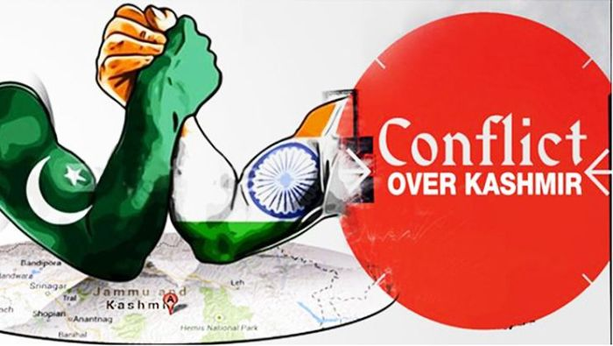
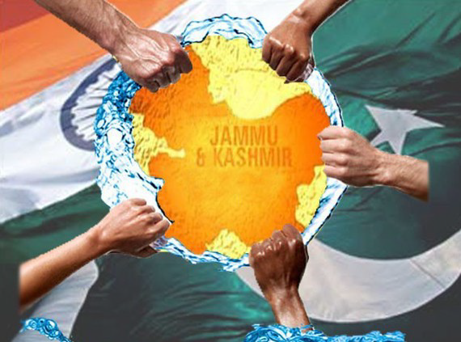
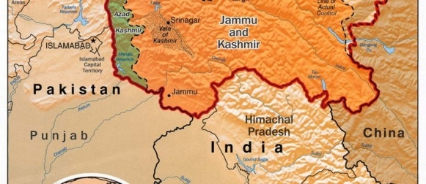
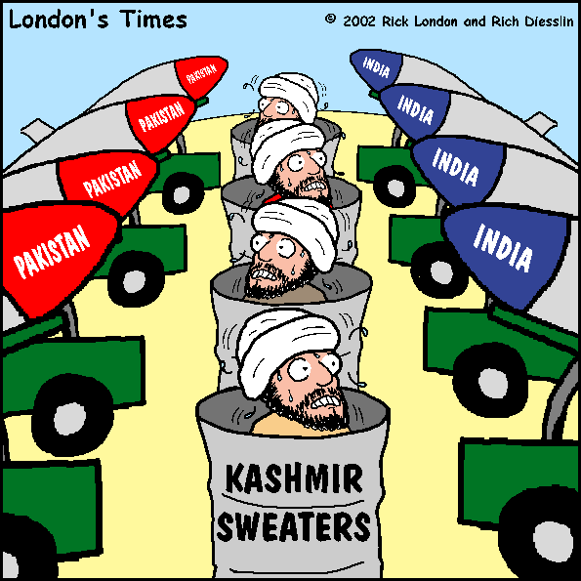
Kashmir Dispute

Slide 29
14. India Office Library:
India Office Library is the inheritance treasure of knowledge having more than 2,30,000 books and more than 25,000 hand written rare manuscripts.
It is a rare collection of the Indo-Pakistan civilization, culture and history.
But the division of the assets of India Office Library is still neglected.

Slide 30
15. Membership of International Organizations:
India had both rights and duties of being member of International Organizations.
Pakistan had to re-apply for its membership in these International Organizations.
Pakistan as a new country had to establish its embassies in different countries.
This problem was financial as well as administrative in nature.

Slide 31
Conclusion:
Pakistan came into being as a free Muslim state in quite unfavorable circumstances, it had to build up its administrative machinery from a scrap. But supreme efforts were made by the Quaid-e-Azam and his colleagues to grapple with the situation. His golden principles “Unity” “Faith” and “Discipline” gave way to Pakistan for a bright future of a strong and well developed country.
In his last message to the nation on 14th August 1948, he told the nation:
“The Foundation of your state have been laid and it is now for you to build and build as quickly as you can”.
Quaid e Azam was addressing the historic public meeting at Lahore , he said:
“It is now up to you to work, work and work and we are bound to succeed. And never forget our motto Unity, Faith and Discipline.”

Slide 32
THANK YOU

